Slide 1
Introduction to Probability and Statistics
4CM521
Discrete Probability Distributions

Slide 2
Learning Outcomes
At the end of this section, you must be able to:
To grasp the fundamental concepts of discrete probability distributions, including the definition of random variables, probability mass functions (PMFs), and cumulative distribution functions (CDFs).
To apply probability formulas to solve problems involving discrete probability distributions, such as calculating expected values, variances, and standard deviations.
To interpret the results of probability distributions in real-world contexts

Slide 3
Introduction
Often the observations generated by different statistical experiments have the same general type of behavior.
In fact, one needs just a handful of important probability distributions to describe many of the discrete random variables encountered in practice.
We are going to study some of them…

Slide 4
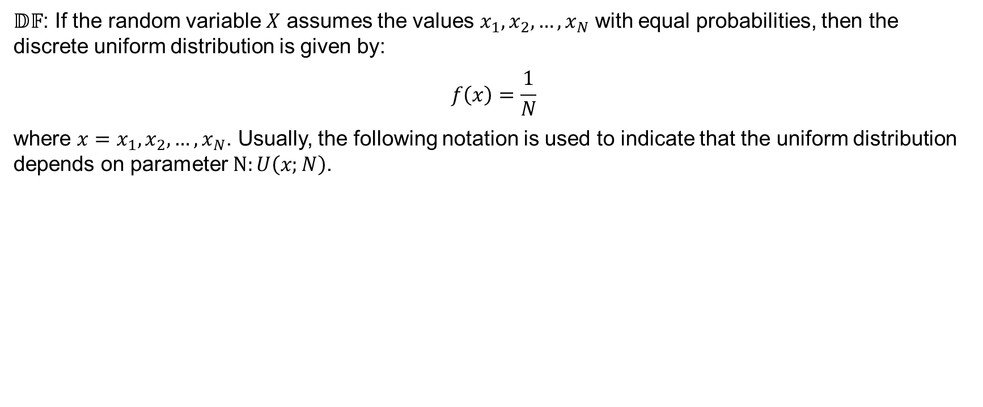
Discrete Uniform Distribution
$𝔻𝔽$: If the random variable $X$ assumes the values $x_{1},x_{2},…,x_{N}$ with equal probabilities, then the discrete uniform distribution is given by:
$$f\left(x\right)=\frac{1}{N}$$
where $x=x_{1},x_{2},…, x_{N}$. Usually, the following notation is used to indicate that the uniform distribution depends on parameter $N:U\left(x;N\right)$.

Slide 5
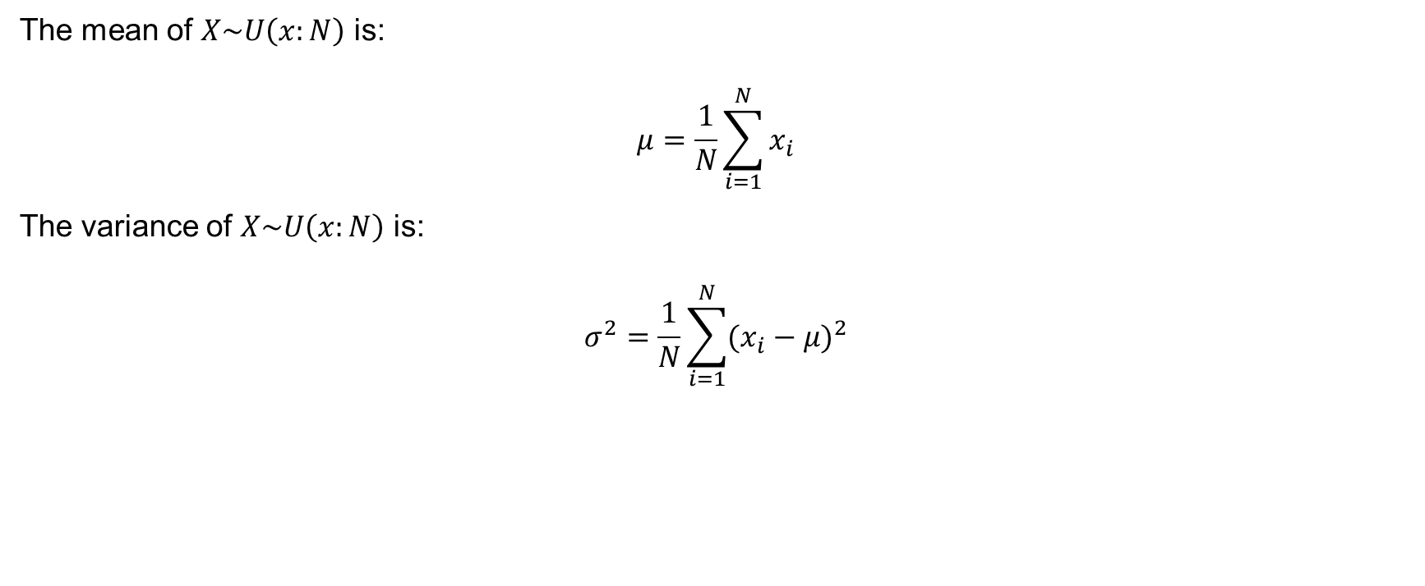
Statistical properties of the discrete uniform distribution
The mean of $X\sim U\left(x:N\right)$ is:
$$μ=\frac{1}{N}\sum_{i=1}^{N}{x_{i}}$$
The variance of $X\sim U\left(x:N\right)$ is:
$$σ^{2}=\frac{1}{N}\sum_{i=1}^{N}{(x_{i}}−μ)^{2}$$

Slide 6
Example 7.1
Example 7.1. A classic example of a discrete uniform distribution is rolling a fair six-sided die. In this case there are six possible outcomes: 1, 2, 3, 4, 5 and 6. Each outcome has a probability of 1/6 of occurring when the die is rolled. The probability of getting any particular number on the die is the same for all numbers. See below the probability distribution table for rolling a fair six-sided die:
Outcome | Probability
1 | 1/6
2 | 1/6
3 | 1/6
4 | 1/6
5 | 1/6
6 | 1/6

Slide 7
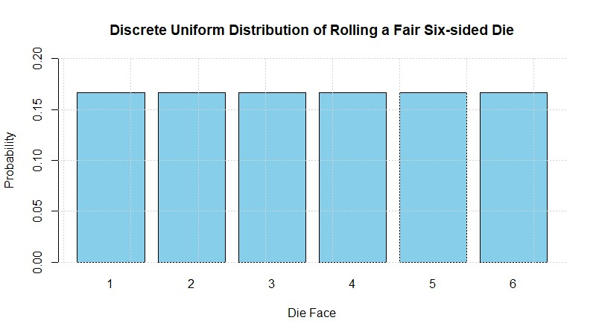
Example 7.1 (continued)
The plot of this is given below. The equal bar lengths shows that each outcome has equal probabilities.

Slide 8
Binomial Distribution
An experiment often consists of repeated trials, each with two possible outcomes that may be labelled as “success” and “failure”. This process is referred to as Bernoulli process and each trial is called a Bernoulli trial.
Strictly speaking, the Bernoulli process must possess the following properties:
  the experiment consists of n repeated trials;
  each trial results in an outcome that may be classified as a success or a failure;
  the probability of success, p, remains constant from trial to trial;
  the repeated trials are independent.

Slide 9
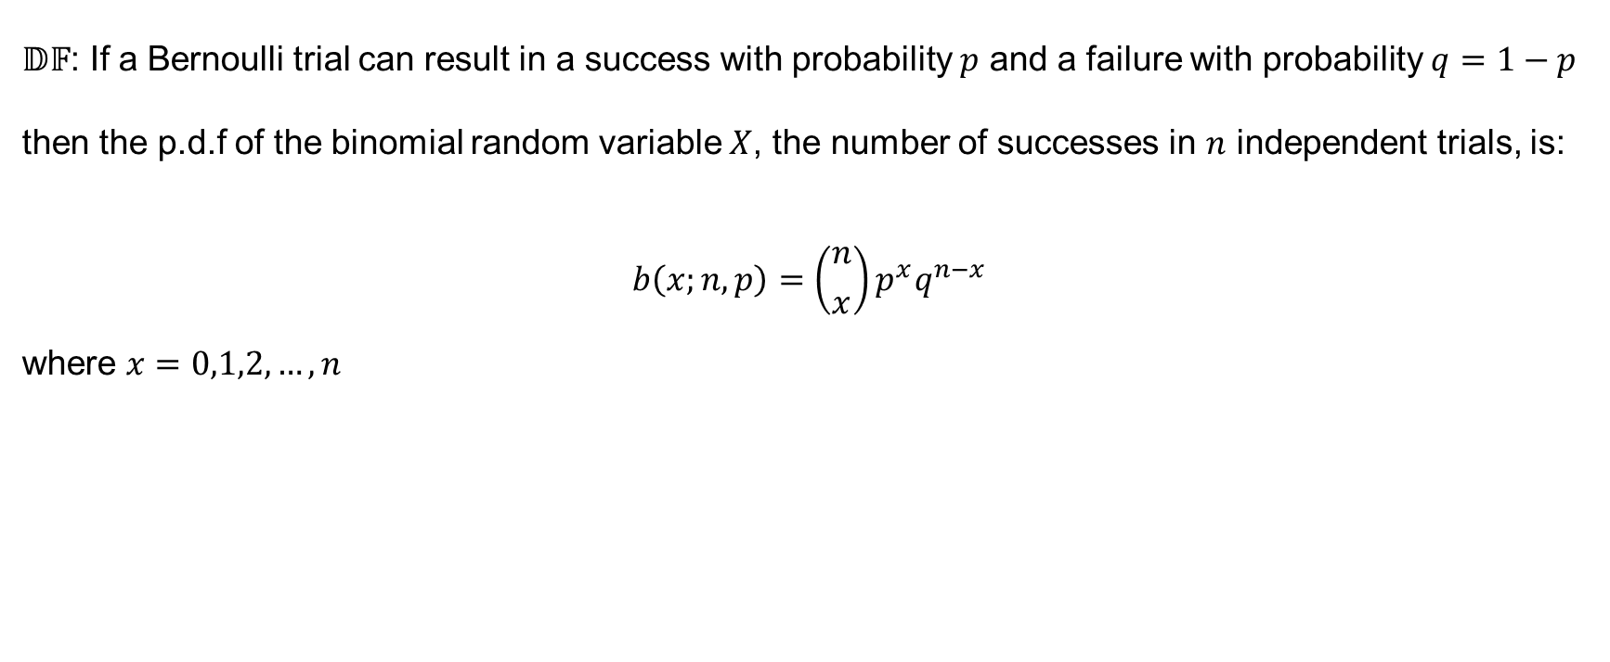
Definition of the Bernoulli trial
$𝔻𝔽$: If a Bernoulli trial can result in a success with probability $p$ and a failure with probability $q=1−p$ then the p.d.f of the binomial random variable $X$, the number of successes in $n$ independent trials, is:
$$b\left(x;n,p\right)=\left({n \atop x}\right)p^{x}q^{n−x}$$
where $x=0,1,2,…,n$

Slide 10
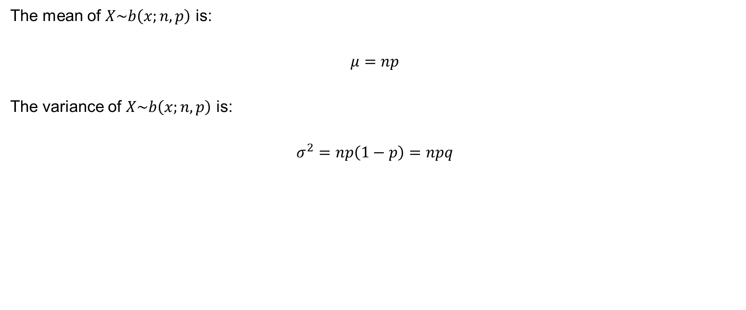
Statistical properties of the Bernoulli trial
The mean of $X\sim b\left(x;n,p\right)$ is:
$$μ=np$$
The variance of $X\sim b\left(x;n,p\right)$ is:
$$σ^{2}=np\left(1−p\right)=npq$$

Slide 11
Example 7.2
The probability that a patient recover from a rare blood disease is 0.4. If 15 people are known to contract this disease, what is the probability that
at least 10 survive;
from 3 to 8 survive;
and exactly 5 survive?

Slide 12
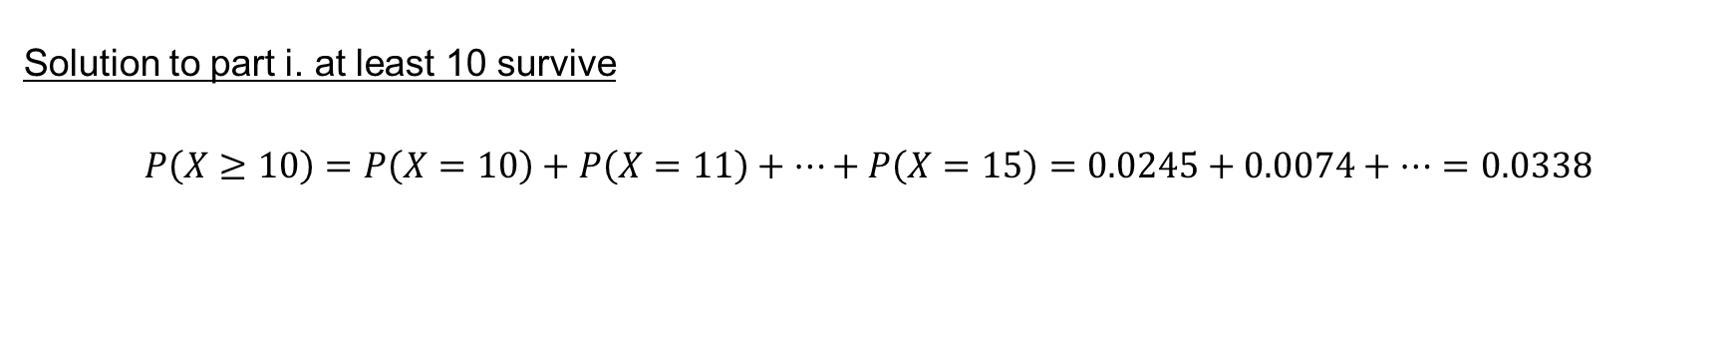
Example 7.2 (continued)
Solution to part i. at least 10 survive
$$P\left(X≥10\right)=P\left(X=10\right)+P\left(X=11\right)+…+P\left(X=15\right)=0.0245+0.0074+…=0.0338$$

Slide 13
Example 7.2 (continued)
Do it in R:
#pbinom(q, size, prob, lower.tail = TRUE, log.p = FALSE)
# Calculate the complement probability (P(X < 10))
probability_at_least_10 <- 1 - pbinom(q = 9, size = 15, prob = 0.4, lower.tail = TRUE)
# q = 9 One less than the minimum number of survivors for the complement
# size = 15 Number of trials (people)
# prob = 0.4 Probability of survival for each person
# lower.tail = TRUE
#probability_at_least_10
#0.0338333

Slide 14
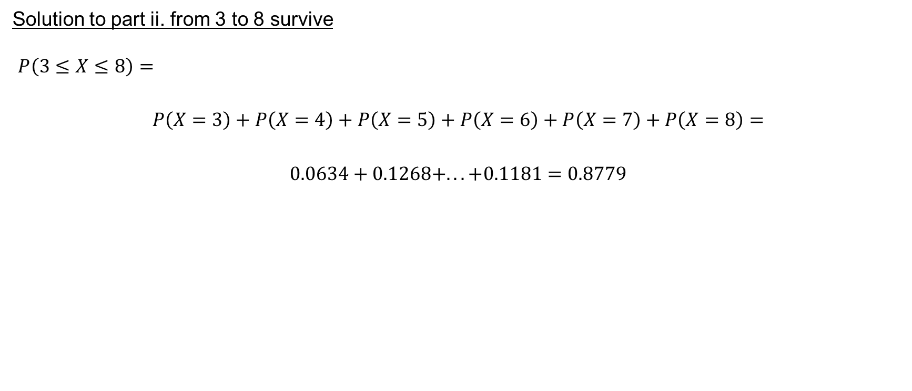
Example 7.2 (continued)
Solution to part ii. from 3 to 8 survive
$P\left(3≤X≤8\right)=$
$$P\left(X=3\right)+P\left(X=4\right)+P\left(X=5\right)+P\left(X=6\right)+P\left(X=7\right)+P\left(X=8\right)=$$
$$0.0634+0.1268+...+0.1181=0.8779$$

Slide 15
Example 7.2 (continued)
Do it in R:
# Probability that between 3 and 8 survive prob_3_to_8 <- sum(dbinom(3:8, size = 15, prob = 0.4)) # Display the probability prob_3_to_8
## [1] 0.8778386

Slide 16
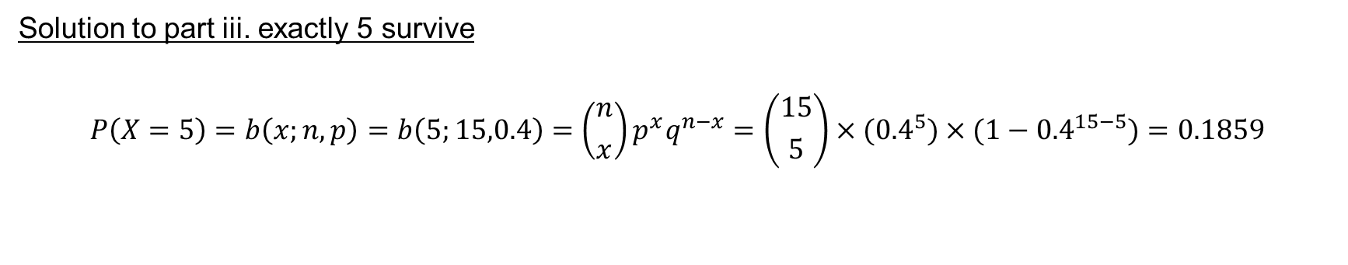
Example 7.2 (continued)
Solution to part iii. exactly 5 survive
$$P\left(X=5\right)=b\left(x;n,p\right)=b\left(5;15,0.4\right)=\left({n \atop x}\right)p^{x}q^{n−x}=\left({15 \atop 5}\right)×{(0.4}^{5})×({1−0.4}^{15−5})=0.1859$$

Slide 17
Example 7.2 (continued)
Do it in R:
# Probability that exactly 5 survive prob_exactly_5 <- dbinom(5, size = 15, prob = 0.4) # Display the probability prob_exactly_5
## [1] 0.1859378

Slide 18
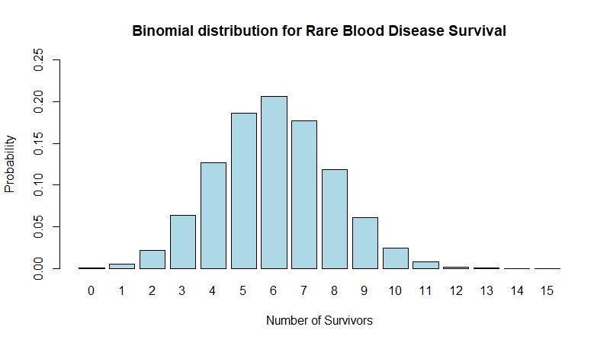
Example 7.2 (continued)

Slide 19
Additional notes
For the probabilities obtained in part ii. and iii., they can be obtained using R or using the Binomial formula or from the table of Binomial probabilities.
For the latter, maybe try it out a few times, but in recent years we tend to reply on computers. Since tables are pre-computed and rounded estimates, computers tend to be more accurate.
This also applies to all the other probability distributions explored in this module.

Slide 20
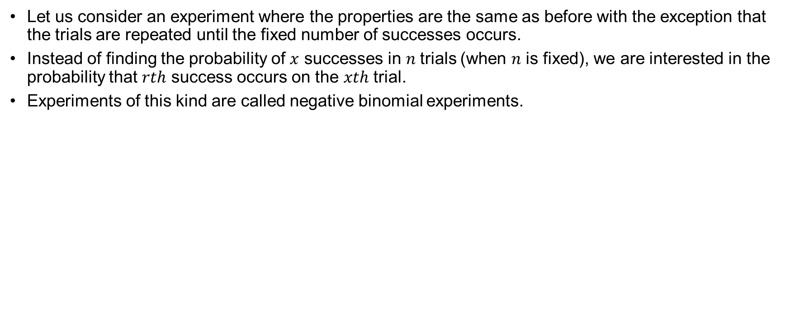
Negative Binomial Distribution
Let us consider an experiment where the properties are the same as before with the exception that the trials are repeated until the fixed number of successes occurs.
Instead of finding the probability of $x$ successes in $n$trials (when $n$ is fixed), we are interested in the probability that $rth$ success occurs on the $xth$ trial.
Experiments of this kind are called negative binomial experiments.

Slide 21
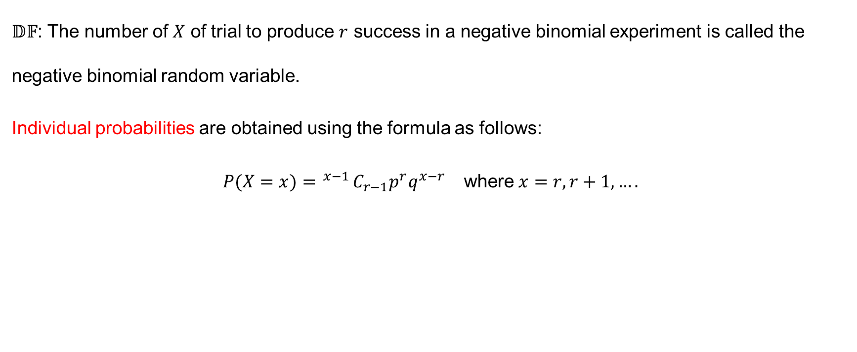
Negative Binomial Distribution (continued)
$𝔻𝔽$: The number of $X$ of trial to produce $r$ success in a negative binomial experiment is called the negative binomial random variable.
Individual probabilities are obtained using the formula as follows:
$$\begin{matrix}P(X=x)= ^{x−1}C_{r−1}p^{r}q^{x−r} & \text{where} x=r, r+1,….\end{matrix}$$

Slide 22
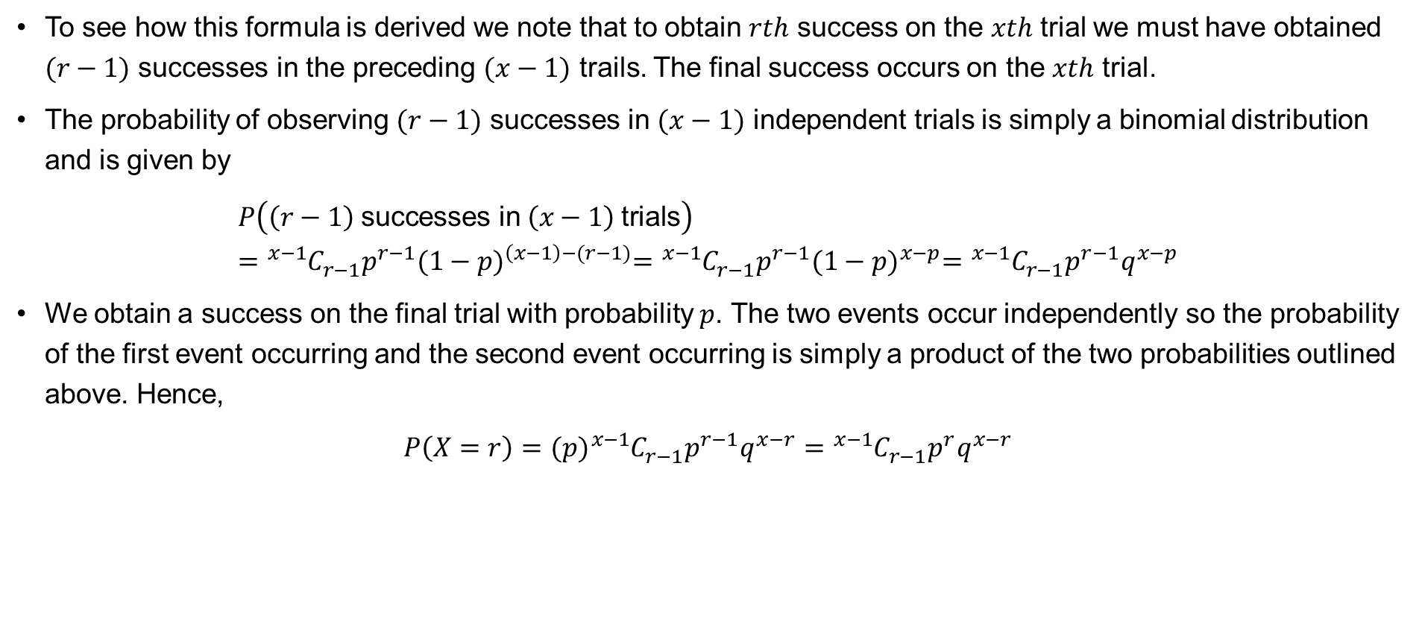
Derivation
To see how this formula is derived we note that to obtain $rth$ success on the $xth$ trial we must have obtained $(r−1)$ successes in the preceding $(x−1)$ trails. The final success occurs on the $xth$ trial.
The probability of observing $(r−1)$ successes in $(x−1)$ independent trials is simply a binomial distribution and is given by
$$P\left(\left(r−1\right) \text{successes} \text{in} \left(x−1\right) \text{trials}\right)={}_{ }^{x−1}{C_{r−1}^{ }p^{r−1}{(1−p)}^{\left(x−1\right)−(r−1)}={}_{ }^{x−1}{C_{r−1}^{ }p^{r−1}{(1−p)}^{x−p}={}_{ }^{x−1}{C_{r−1}^{ }p^{r−1}q^{x−p}}}}$$
We obtain a success on the final trial with probability $p$. The two events occur independently so the probability of the first event occurring and the second event occurring is simply a product of the two probabilities outlined above. Hence,
$$P\left(X=r\right)=(p){{}_{ }^{x−1}C}_{r−1}^{ }p^{r−1}q^{x−r}={{}_{ }^{x−1}C}_{r−1}^{ }p^{r}q^{x−r}$$

Slide 23
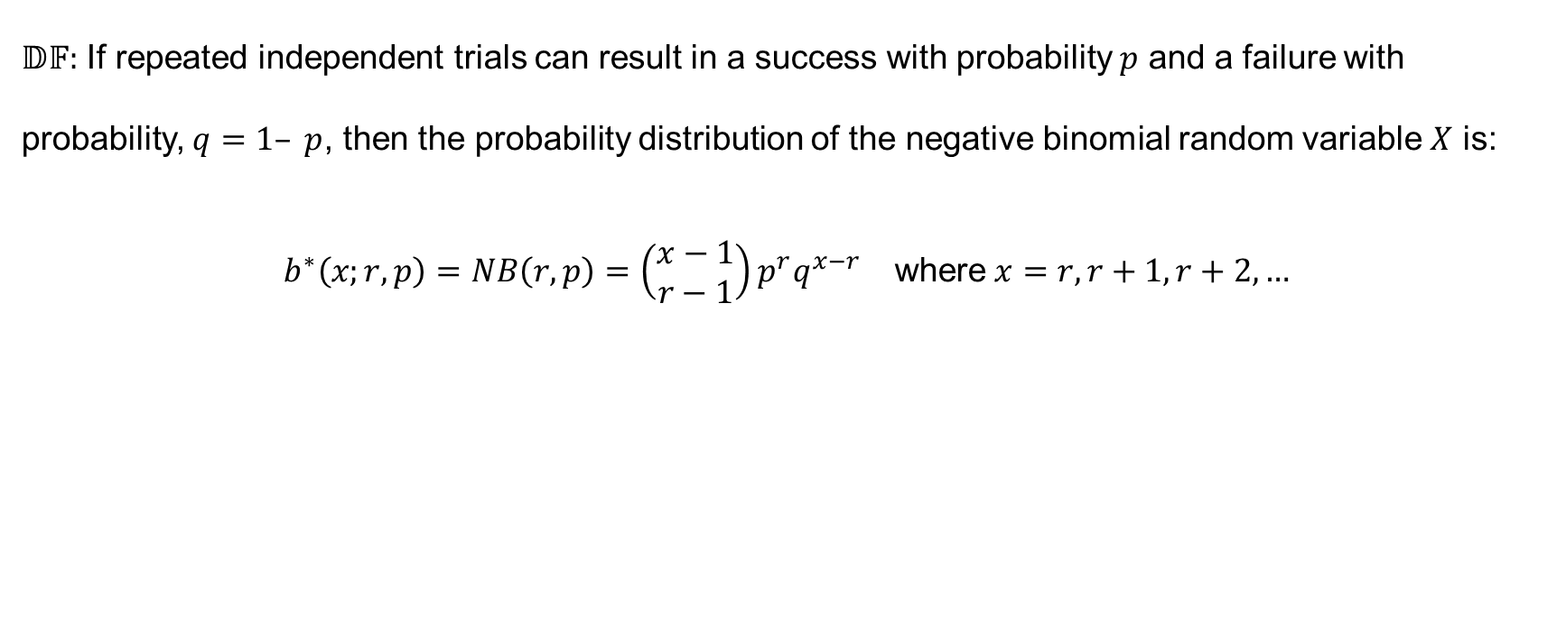
Definition
$𝔻𝔽:$ If repeated independent trials can result in a success with probability $p$ and a failure with probability, $q=1– p$, then the probability distribution of the negative binomial random variable $X$ is:
$$\begin{matrix}b^{∗}\left(x;r,p\right)=NB\left(r,p\right)=\left(\begin{matrix}x−1 \\ r−1\end{matrix}\right)p^{r}q^{x−r} & \text{where} x=r, r+1, r+2,…\end{matrix}$$

Slide 24
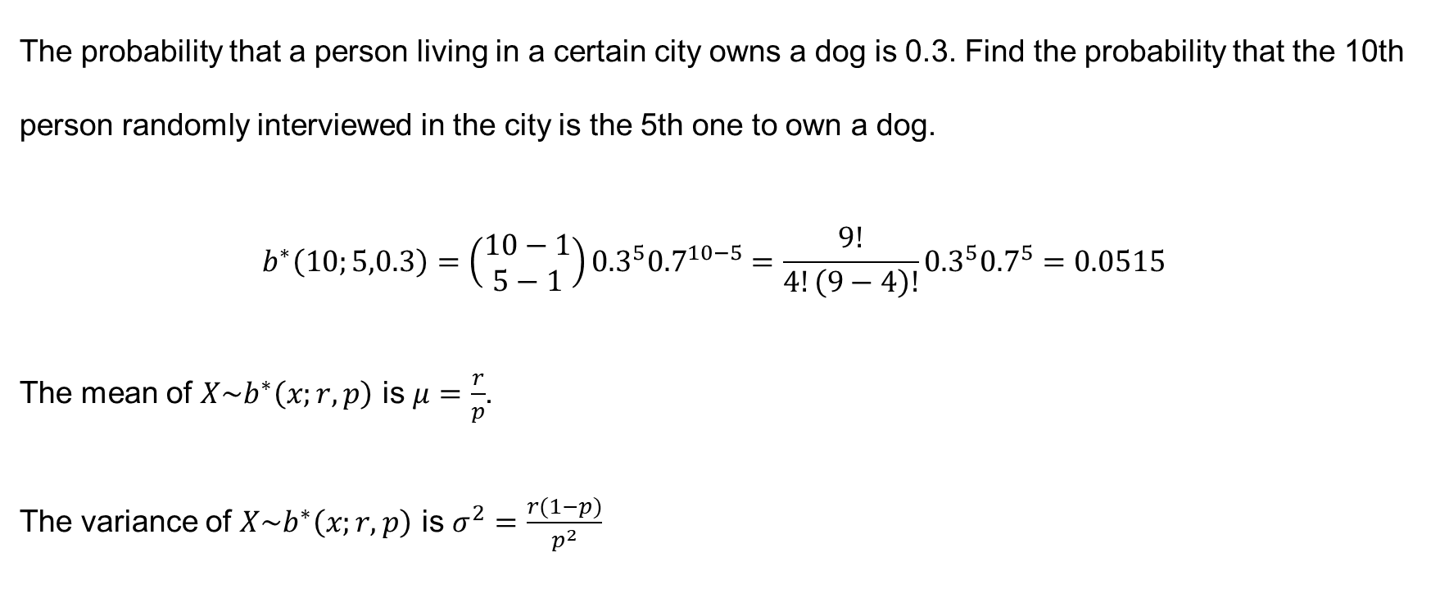
Example 7.3
The probability that a person living in a certain city owns a dog is 0.3. Find the probability that the 10th person randomly interviewed in the city is the 5th one to own a dog.
$$b^{∗}\left(10;5,0.3\right)=\left(\begin{matrix}10−1 \\ 5−1\end{matrix}\right){0.3}^{5}{0.7}^{10−5}=\frac{9!}{4!\left(9−4\right)!}{0.3}^{5}{0.7}^{5}=0.0515$$
The mean of $X\sim b^{∗}\left(x;r,p\right)$ is $μ=\frac{r}{p}$.
The variance of $X\sim b^{∗}\left(x;r,p\right)$ is $σ^{2}=\frac{r(1−p)}{p^{2}}$

Slide 25
Example 7.3 (continued)
#negative binominal
# Calculate the probability of observing the 5th success on the 10th trial
# x-k = 10-5 (parameter 1)
# size refers to r’th successes.
dnbinom(x = 5, size = 5, prob = 0.3)
## [1] 0.05145967

Slide 26
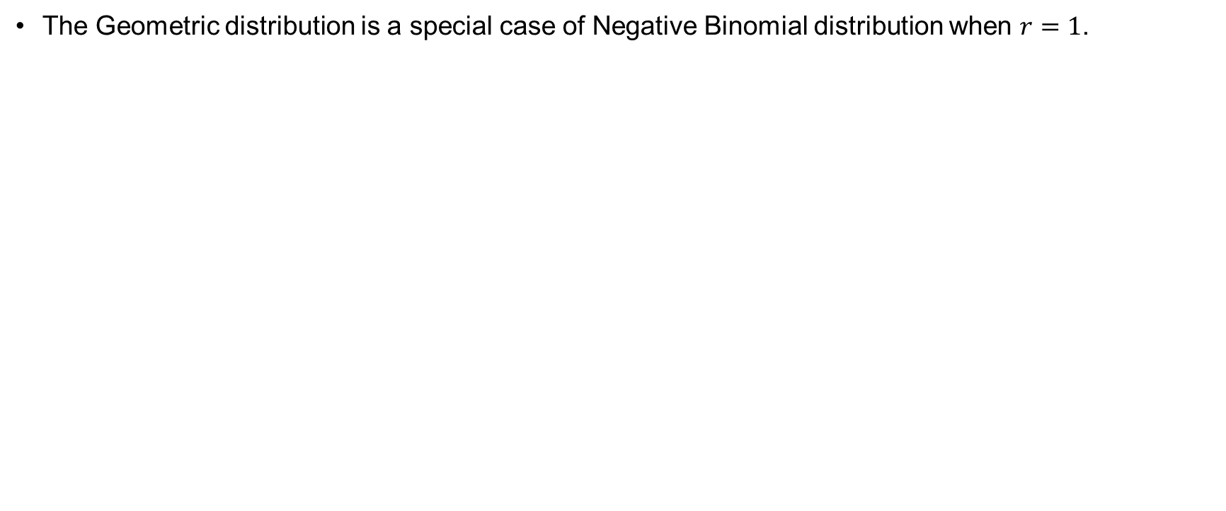
Geometric Distribution
The Geometric distribution is a special case of Negative Binomial distribution when $r=1$.

Slide 27
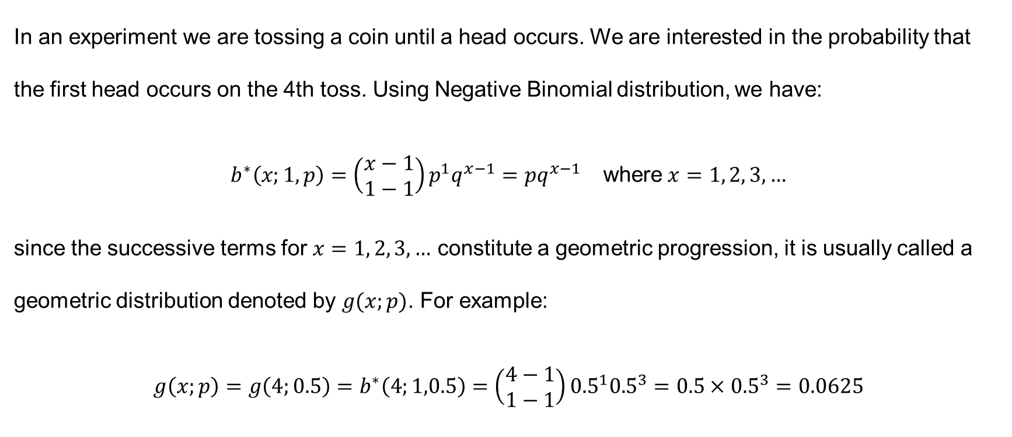
Example 7.4
In an experiment we are tossing a coin until a head occurs. We are interested in the probability that the first head occurs on the 4th toss. Using Negative Binomial distribution, we have:
$$\begin{matrix}b^{∗}\left(x;1,p\right)=\left(\begin{matrix}x−1 \\ 1−1\end{matrix}\right)p^{1}q^{x−1}=pq^{x−1} & \text{where} x=1, 2, 3, …\end{matrix}$$
since the successive terms for $x=1, 2, 3, …$ constitute a geometric progression, it is usually called a geometric distribution denoted by $g(x;p)$. For example:
$$g\left(x;p\right)=g\left(4;0.5\right)=b^{∗}\left(4;1,0.5\right)=\left(\begin{matrix}4−1 \\ 1−1\end{matrix}\right){0.5}^{1}{0.5}^{3}=0.5×{0.5}^{3}=0.0625$$

Slide 28
Example 7.4 (continued)
Do it in R:
# Given values
p <- 0.5 # Probability of getting a head
k <- 1 # We want the first success (k = 1)
n <- 4 # On the 4th toss
# Calculate the probability using the Negative Binomial distribution prob_4th_is_1st_head <- dnbinom(n - k, size = k, prob = p)
# Display the probability prob_4th_is_1st_head
## [1] 0.0625

Slide 29
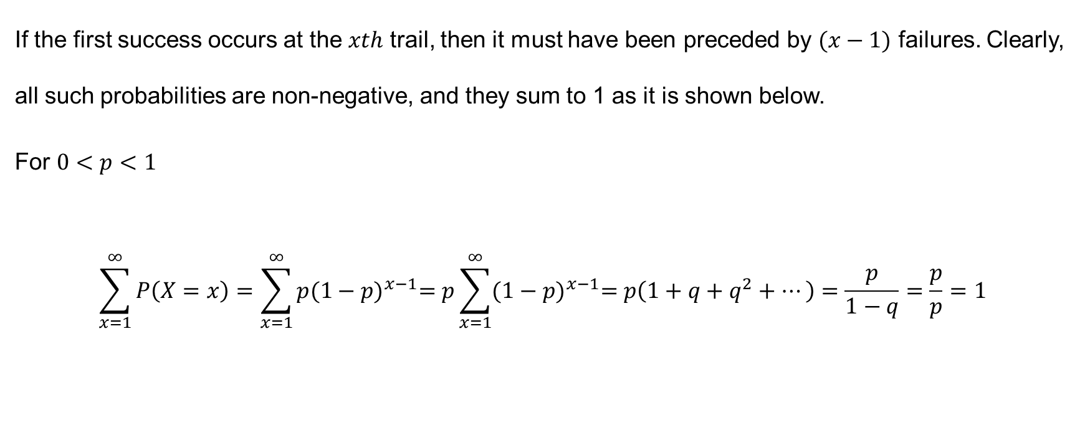
Note
If the first success occurs at the $xth$ trail, then it must have been preceded by $(x−1)$ failures. Clearly, all such probabilities are non-negative, and they sum to 1 as it is shown below.
For $0<p<1$
$$\sum_{x=1}^{∞}{P\left(X=x\right)=\sum_{x=1}^{∞}{p{(1−p)}^{x−1}=p\sum_{x=1}^{∞}{{(1−p)}^{x−1}=p\left(1+q+q^{2}+…\right)=\frac{p}{1−q}=\frac{p}{p}=1}}}$$

Slide 30
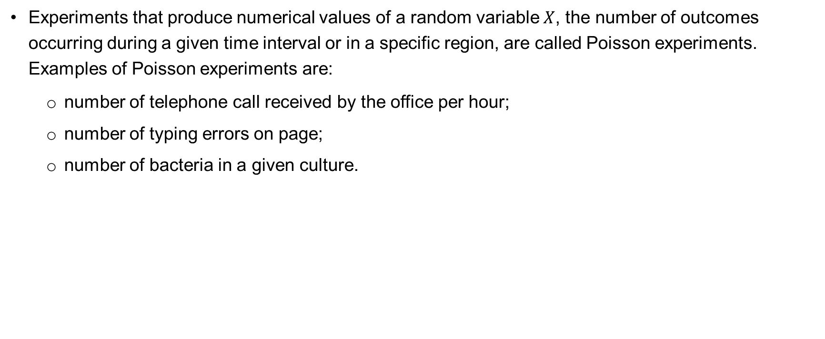
Poisson Distribution
Experiments that produce numerical values of a random variable $X$, the number of outcomes occurring during a given time interval or in a specific region, are called Poisson experiments. Examples of Poisson experiments are:
  number of telephone call received by the office per hour;
  number of typing errors on page;
  number of bacteria in a given culture.

Slide 31
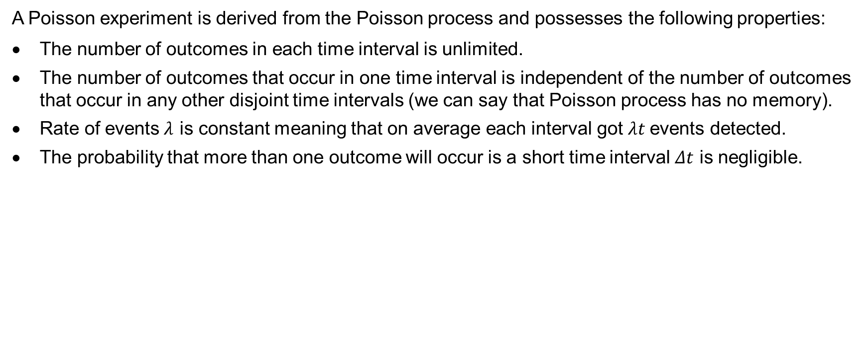
Properties of Poisson process
A Poisson experiment is derived from the Poisson process and possesses the following properties:
The number of outcomes in each time interval is unlimited.
The number of outcomes that occur in one time interval is independent of the number of outcomes that occur in any other disjoint time intervals (we can say that Poisson process has no memory).
Rate of events$λ$ is constant meaning that on average each interval got$λt$ events detected.
The probability that more than one outcome will occur is a short time interval $Δt$ is negligible.

Slide 32
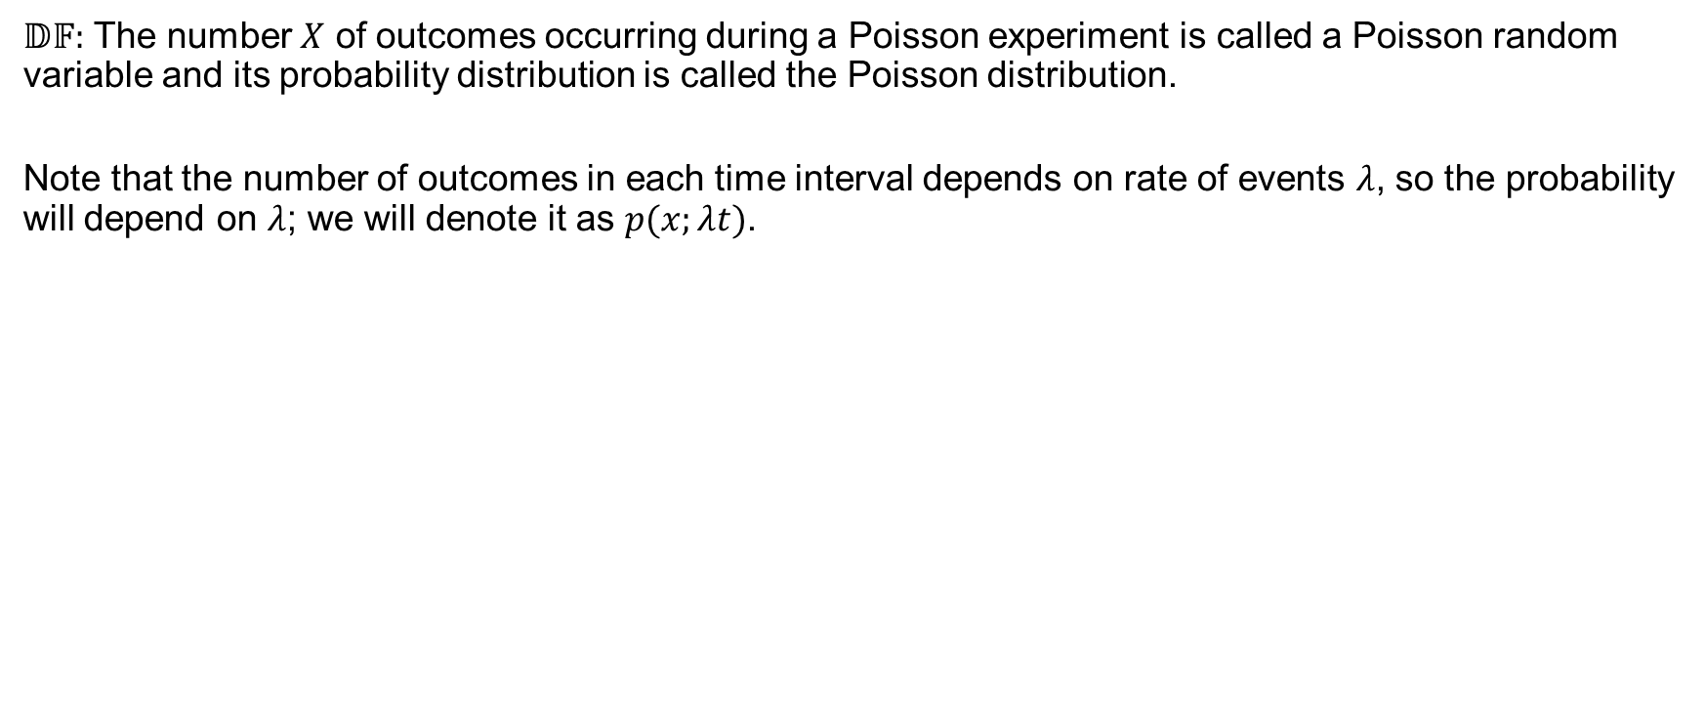
Poisson Definition
$𝔻𝔽:$ The number $X$ of outcomes occurring during a Poisson experiment is called a Poisson random variable and its probability distribution is called the Poisson distribution.
Note that the number of outcomes in each time interval depends on rate of events $λ$, so the probability will depend on $λ$; we will denote it as $p(x;λt)$.

Slide 33
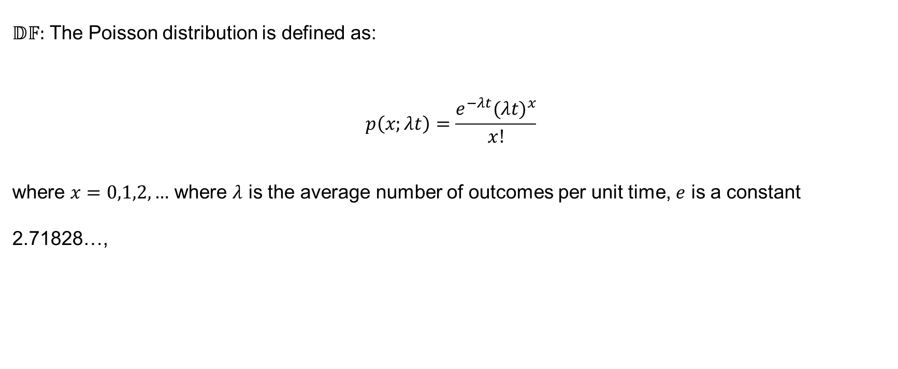
Definition
$𝔻𝔽:$ The Poisson distribution is defined as:
$$p\left(x;λt\right)=\frac{e^{−λt}{(λt)}^{x}}{x!}$$
where $x=0,1,2,…$ where $λ$ is the average number of outcomes per unit time, $e$ is a constant 2.71828…,

Slide 34
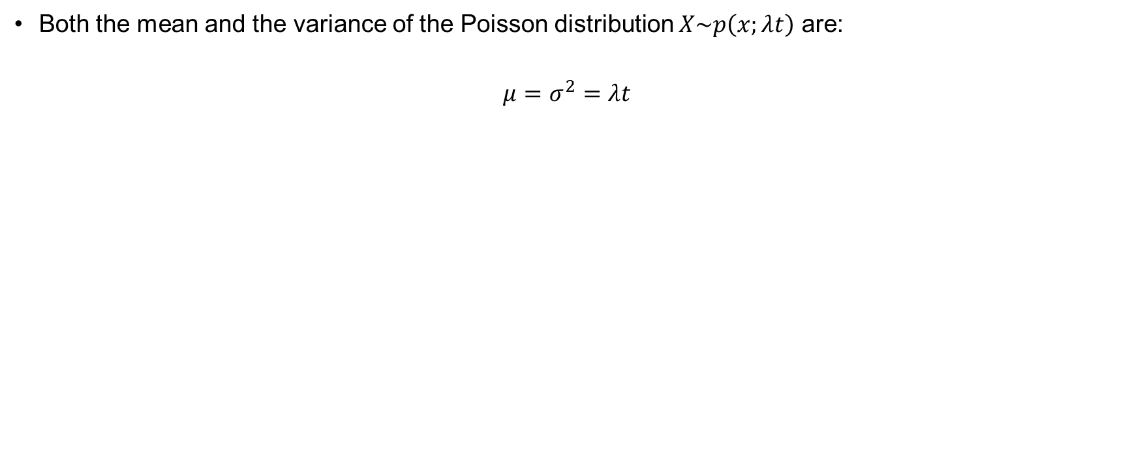
Statistical properties
Both the mean and the variance of the Poisson distribution $X\sim p\left(x;λt\right)$ are:
$$μ=σ^{2}=λt$$

Slide 35
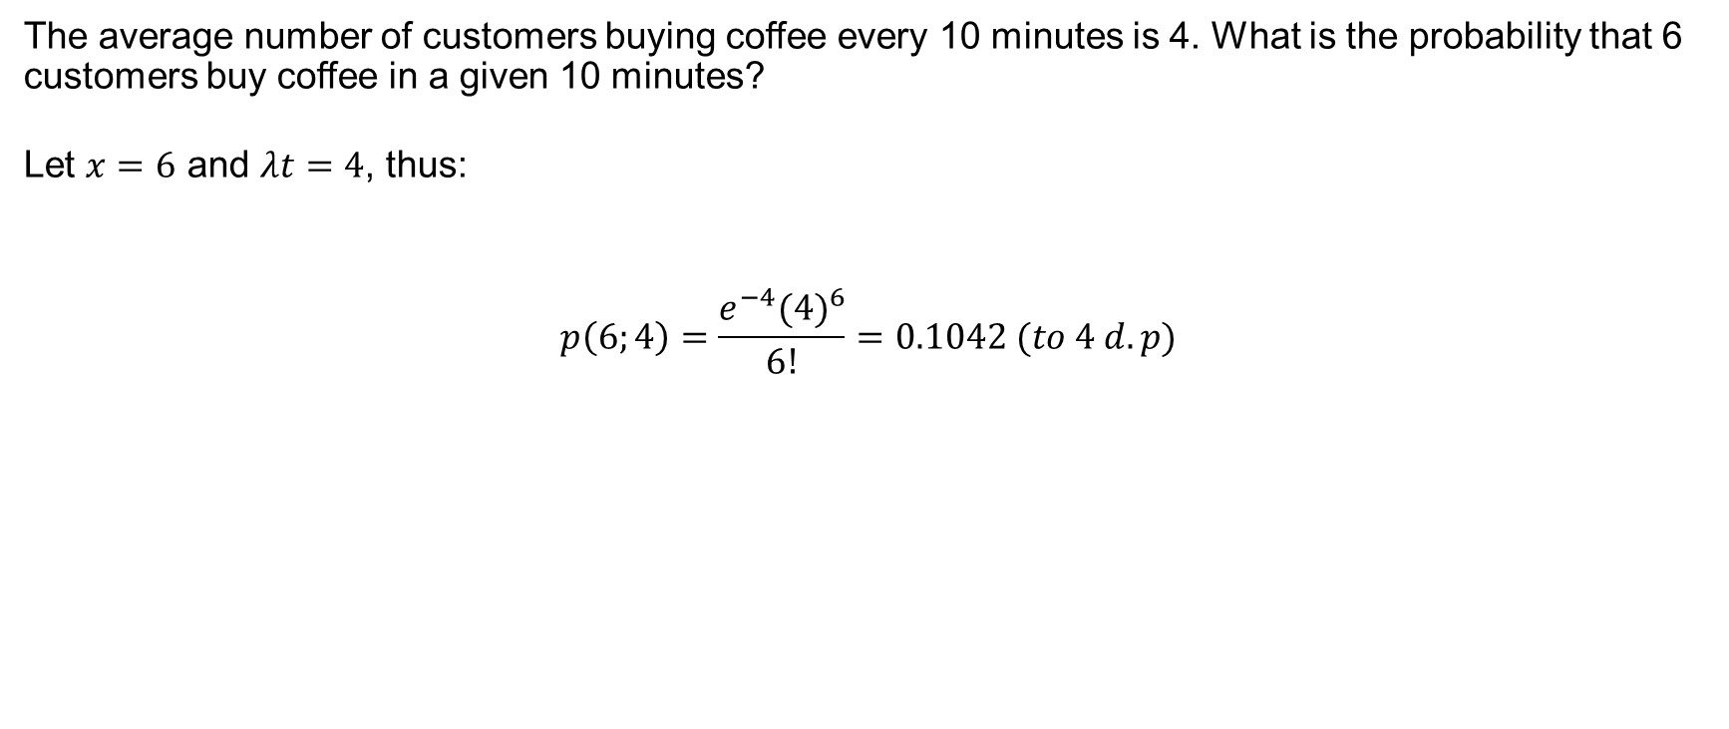
Example 7.5
The average number of customers buying coffee every 10 minutes is 4. What is the probability that 6 customers buy coffee in a given 10 minutes?
Let $x=6$ and $λt=4$, thus:
$$p\left(6;4\right)=\frac{e^{−4}{(4)}^{6}}{6!}=0.1042 (to 4 d.p)$$

Slide 36
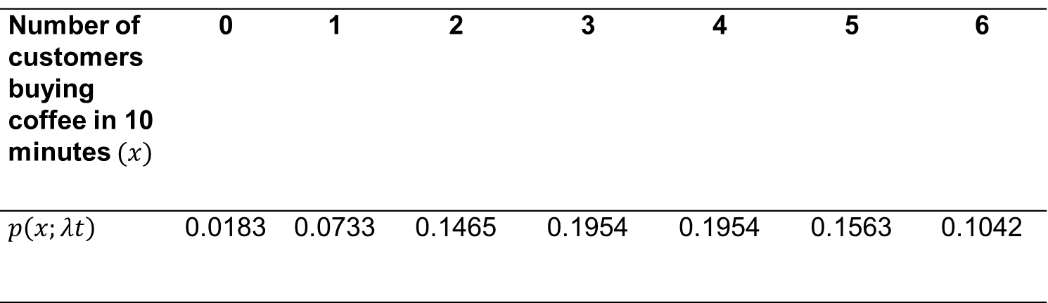
Example 7.5 (continued)
We can extend this example by considering other values of $x$. Substituting other values of $x$, we obtain
Number of customers buying coffee in 10 minutes $(x)$ | 0 | 1 | 2 | 3 | 4 | 5 | 6
$$p\left(x;λt\right)$$ | 0.0183 | 0.0733 | 0.1465 | 0.1954 | 0.1954 | 0.1563 | 0.1042

Slide 37
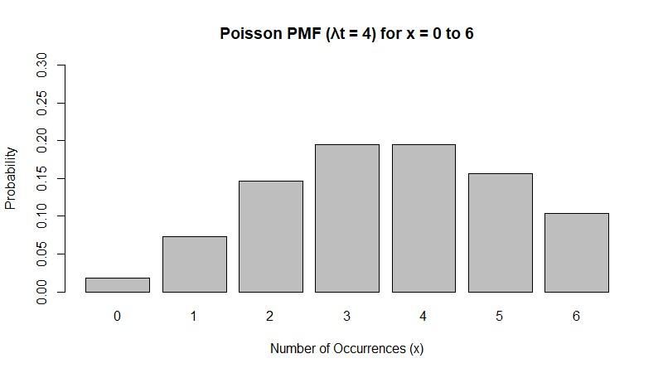
Example 7.5 (continued)

Slide 38
Summary
These are a handful of discrete distributions.
Many of them of common and well used in the statistics world.
There are many more for you to explore.

